Slide 1
Rating Prediction Project
Name: Sumit Santra

Slide 2
Problem Statement: -
We have a client who has a website where people write different reviews for technical products. Now they are adding a new feature to their website i.e. The reviewer will have to add stars(rating) as well with the review. The rating is out 5 stars and it only has 5 options available 1 star, 2 stars, 3 stars, 4 stars, 5 stars. Now they want to predict ratings for the reviews which were written in the past and they don’t have a rating. So, we have to build an application which can predict the rating by seeing the review.

Slide 3

Exploratory Data Analysis
Exploratory Data Analysis for 1 star reviews:
From above we can see the top 20 words for 1 star reviews.

Slide 4
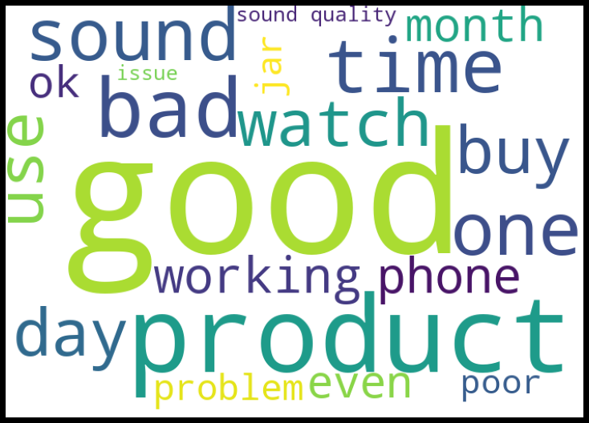
Exploratory Data Analysis
Exploratory Data Analysis for 2 Star reviews:
From above we can see the top 20 Words that are in 2 star reviews

Slide 5
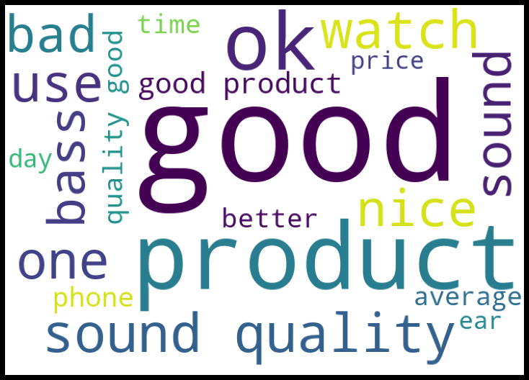
Exploratory Data Analysis
Exploratory Data Analysis for 3 Star reviews
From above we can see top 20 words for 3 star reviews from here we can see good reviews for the products

Slide 6
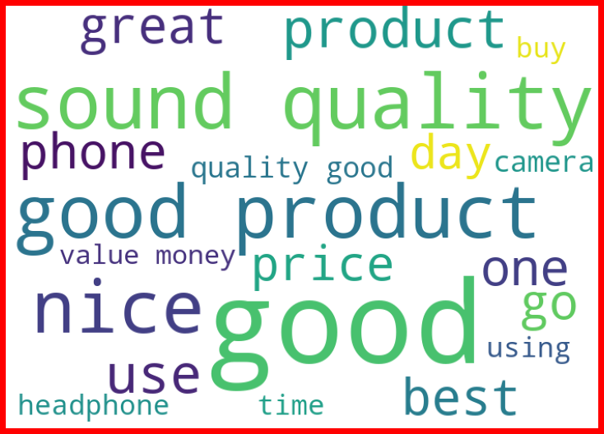
Exploratory Data Analysis
Exploratory Data Analysis for 4 star reviews
From above we can see the top 20 reviews for all the product rated as 4

Slide 7
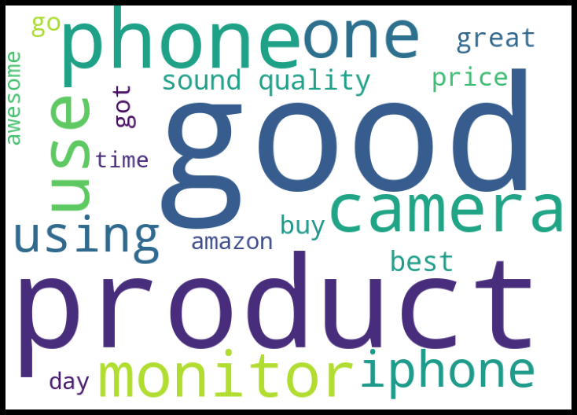
Exploratory Data analysis
Exploratory Data analysis for 5 star reviews
From above we can see top 20 Words for 5 star rating this is the top rating in modt of the e commerce website.

Slide 8
Algorithms used
Decision Tree Classifier
Extra Tree Classifier
Random Forest Classifier
Adaboost Classifier
Support Vector Classifier
Kneighbours Classifier
XGBoost Classifier
XGBRF Classifier

Slide 9
Steps followed for problem solving
I started by looking at the dataset and removing the null values present in the dataset after removing the null data from the columns
After removing the null values I left with the raw data and found that there where more data which has same meaning but different cases such as Big and big has same meaning but there case differs and because of which the dataset get bigger after performing vectorization.
So I converted all the data in the rows to lower case and then I performed Stopwords removal from the dataset as stopword has no meaning so we can remove those.
After removing stopwords my main focus was removing punctuations from the dataset as it will increase the size of the dataset.
After removing the punctuations I performed Term Frequency and inverse document frequency so that I can get unique vectors for each and every word
After tfidf using for loop I changed the max_columns parameter in rfidf and found max_feature = 11000 has the highest accuracy so I used that for each and every model.

Slide 10
Limitation of this project
There are some limitations in this work as we have only trained our model on 22000 rows and 11000 column and there are many other English word which model has not trained on so if that word appears in that reviews the model may mis interpret and give wrong reviews .
As we have trained the model only on English language so if the comments are in Hindi or any other language then also the model will mis interpret and gives wrong results.
To Improve the model we can add more columns and train them on those columns and if we want to make a model which has Multi language reviews then we must also train out model with those language reviews and we are good to go.

